Slide 1
Consumer Markets and
Consumer Buying Behavior

Slide 2
Consumer Market:
All the individuals and house holds who buy or acquire goods and services for personal consumption.

Slide 3
Consumer Buying Behavior
The buying behavior of final consumers___ individuals and house holds who buy goods and services for personal consumption.

Slide 4
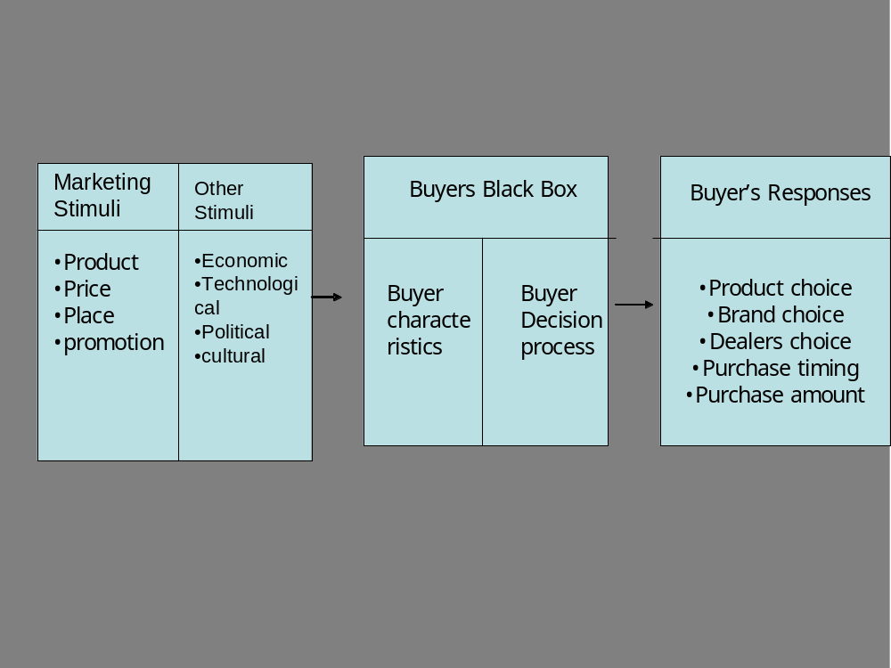

Slide 5
Characteristics affecting Consumer Behavior
Cultural factors
Social factors
Personal factors
Psychological factors

Slide 6
Cultural Factors
Culture
Sub culture
Social class

Slide 7
1) Cultural Factors
Culture:
The set of basic values perceptions, wants, and behaviors learned by a member of society from family and other important institutions.

Slide 8
Cross Cultural Misunderstandings
A simple hand gesture has a no of meanings
i.e. a circle of thumb & forefinger.
In America it signifies something ok
In France it means zero or worthless
Money to the Japanese

Slide 9
Western must learn that white is symbol of
mourning in Asia quite different from western
culture’s white for bridal gowns.
Consequently marketers must adjust their
marketing efforts to cultures to which they
are not attuned.

Slide 10
Sub Culture:
A group of people with shared value systems based on common life experiences and situations, nationalities, religions, racial and geographic regions.

Slide 11
Bilingual sales personnel.
Hispanic prefer bright colors and occasion related clothes.
African American lavish in spending.
Asian American language and cultural tradition
appears to be biggest barriers.

Slide 12
Social Classes:
Relatively permanent and ordered divisions in
a society whose member share similar values,
interests, and behaviors.

Slide 13
2) Social Factors
A consumer behavior is also influenced by social factors, such as the consumer’s small Groups, Family, and Social roles and Status.

Slide 14
Group
Two or more people who interact to accomplish
individual or mutual goals.
Membership Group
Primary group (Family, Friends, Neighbor)
Secondary group ( More formal & less interaction)
Reference Group. Serve as direct and indirect
points of comparison in forming Person’s attitude.
e.g.; an aspirational group

Slide 15
Family
Family members strongly influence buyer behavior. The family is the most important consumer buying organization in a society and been researched intensively.

Slide 16
Role
A role consists of the activities people are expected to perform according to the person around them.
Status
Each role carries a status reflecting the general esteem given to it by society.

Slide 17
3) Personal Factors
Buyer’s age and life cycle stage
Occupation
Economic situation
Lifestyles
Personality and self concept

Slide 18
Family life cycle stages
young | Middle-aged | older
Single | Single | Older married
Married without children | M without c | Older unmarried
Married with children | M with c
Divorced with children | D without c
 | D with c

Slide 19
Personal Factors
Life style
A person’s pattern of living as expressed in
his or her Activities, Interests, and Opinions.
Hobbies, Shopping, Sports and Social event.
Food, Fashion, Family, Media, Job, Achievement and Recreation.
Products, Themselves and Social & Political Issues .

Slide 20
Personal Factors
Occupation :
After learning the professional adopted by people, company can specialize in making products needed by a given occupational group.
As computer software companies will design different products for Brand managers, accountants, engineers, lawyers and doctors etc.

Slide 21
Personal Factors
Economic Situation: A persons affordability will restrict his product choice.
If economic indicators point to a recession, marketers can take steps to redesign, reposition, and reprice their products closely.

Slide 22
Personality
A person’s distinguishing psychological characteristics that lead to relatively consistent and lasting responses to his or her own environment.
Self Confidence
Aggressive
Dynamic
Sociable
Intellectual
Creative
Sophisticated
Competence
e.g.;
Coffee drinkers high on Sociability

Slide 23
Self Concept
Self image or the complex mental pictures people have of themselves.
“ we are what we have” as people’s possessions reflect their identities.
For instance, an intellectual book collector will keep specific types of books which support and rightly reveals his self concept.

Slide 24
4) Psychological Factors
Motivation
Perception
Learning
Beliefs and attitude

Slide 25
Motivation
A need that is sufficiently pressing to direct the person to seek satisfaction of the need.

Slide 26
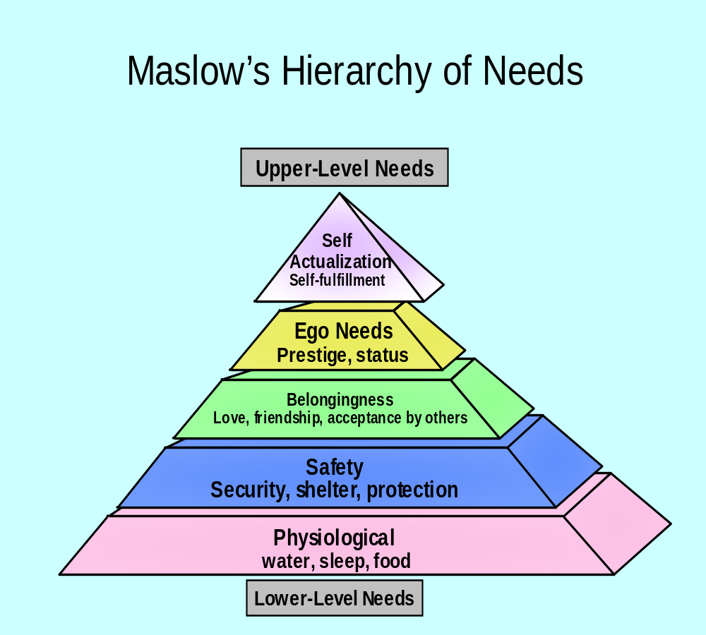

Slide 27
Perception
The process by which people selects organize,
and interpret information to form a meaningful
picture of the world.
selective attention
selective distortion
selective retention

Slide 28
Learning
Changes in an individual’s behavior arising from experience. Learning occurs through the interplay of drives, responses, cues and reinforcement.

Slide 29
Belief
A descriptive thought that a person holds
about something.
Attitude
A person’s consistently favorable unfavorable
evaluations, feelings, and tendencies toward
an object or idea.

